Slide 1
2018-9-26
HQConfig APP User Guide V1.0
Shen Zhen

Slide 2
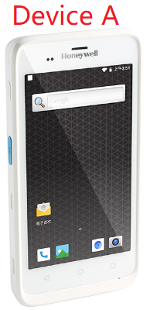
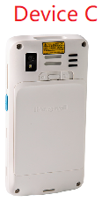
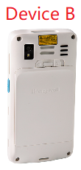
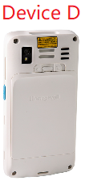
What is HQConfig
HQConfig is a android APP that can be configured and cloned by sync with each other android devices without PC tools ,BT and SIM card.
HQConfig Main Function:
Settings: User can config the system settings and HQConfig settings.
Clone: HQConfig can clone system settings, HQConfig’s settings and APK by scan QR code
Option1: Clone by QR code(Recommend)
Device A: Device which has been configured
Device B/C/D…: Devices need config
Option 2:Clone by Local import

Slide 3
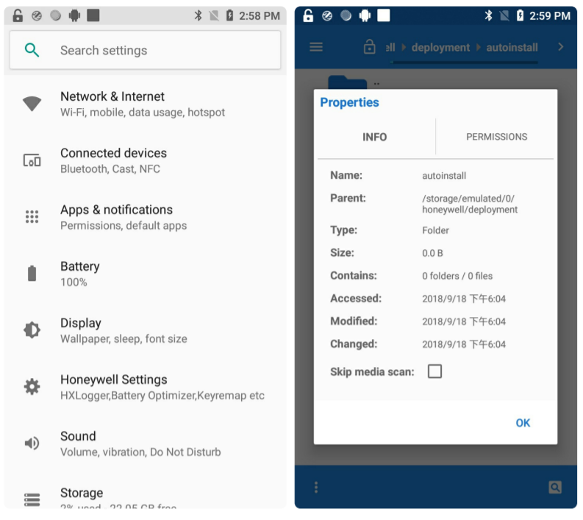
How to use HQConfig(1/4:configuration)
User config settings in system(Figure 1).
Put APK files into Device A path /storage/emulated/0/honeywell/deployment/ (Figure 2).
Config settings which provided by HQConfig(Figure 3).
Figure 1
Figure 2
Figure 3

Slide 4
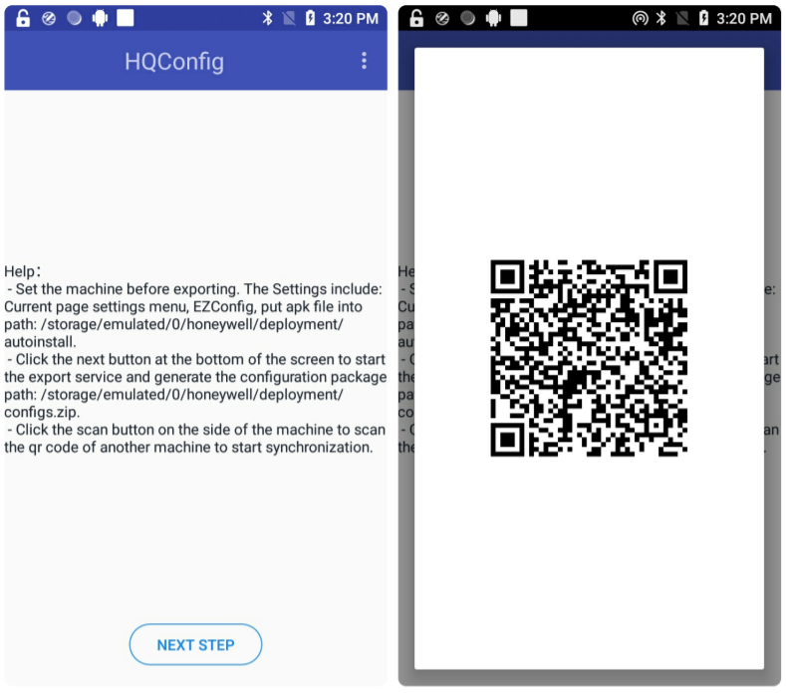

How to use HQConfig(2/4:Generate QR code)
Open HQConfig APP (Figure 1)
Click NEXT STEP Button and generate QR code (Figure 2).
HQConfig ICON
Figure 1
Figure 2

Slide 5
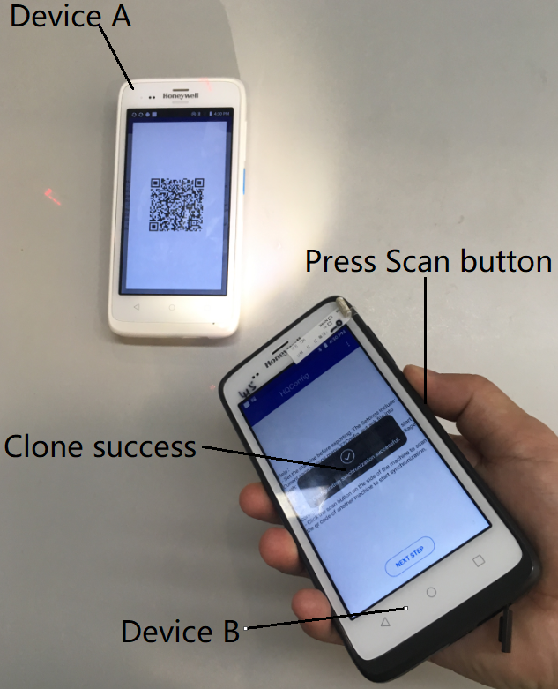
How to use HQConfig(3/4:Scan QR code)
Open HQConfig APP on Device B.
Press Device B’s Scan Button to
scan QR code which generated
by Device A .

Slide 6
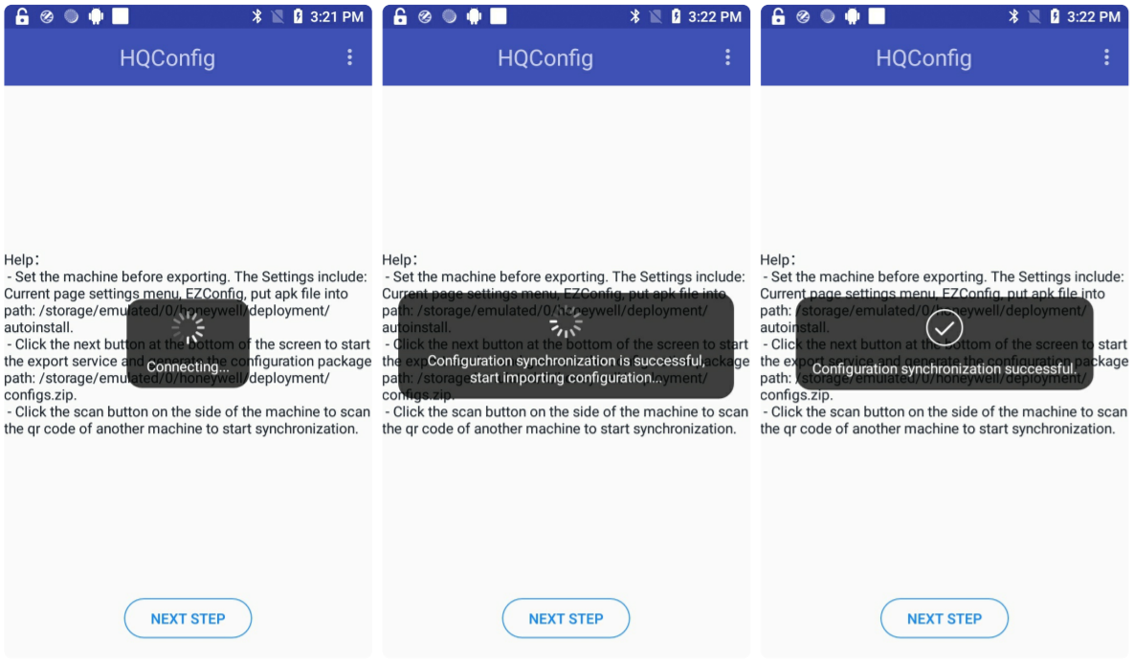
How to use HQConfig(4/4:sync)
HQConfig will clone Settings and APK from Device A to Device B and install APK
on Device B automatically.

Slide 7
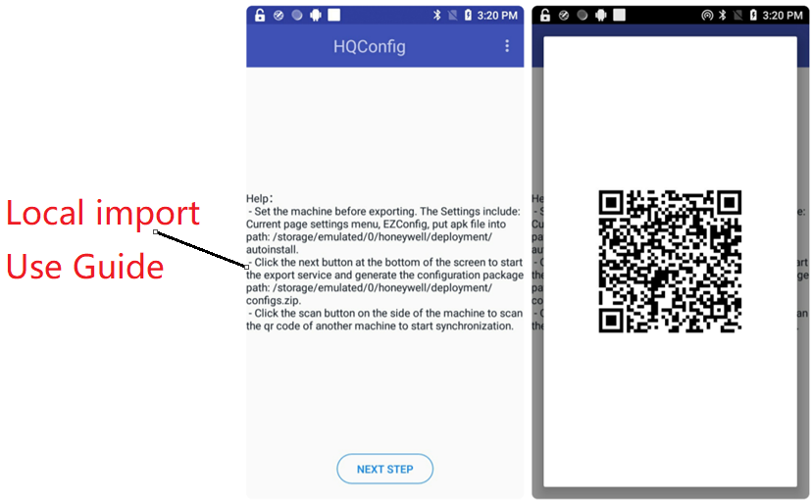
How to use HQConfig Local import(1/2)
If Device A and Device B are not in the same place, How to clone Device A settings and APK to Device B? HQConfig’s Local import function can achieve this request.
Local import steps:
Step 1.Open QR code in Device A,
Config data will be save to /storage/
emulated/0/honeywell/deployment/config.zip.
automatically.
Step 2.Copy config.zip from Device
A ,Push config.zip file to Device B’s path
/storage/IPSM/deployment/.
Step 1

Slide 8
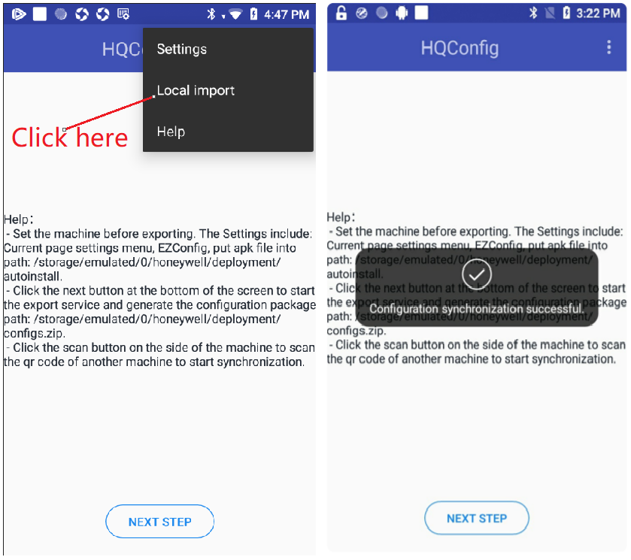
How to use HQConfig Local import(2/2)
Step 3. Click Local import on Device B.
Step 4. HQConfig will config Device B automatically and show result.
Step 3
Step 4

Slide 9
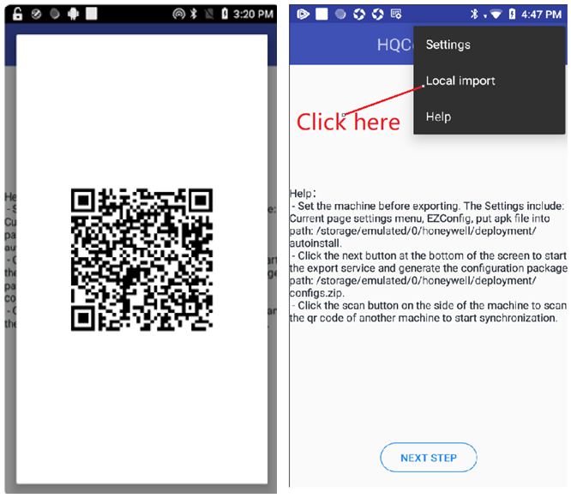
How to install APK only use Device A
Step 1.Open QR code in Device A,
Config data will be save to /storage/
emulated/0/honeywell/deployment/config.zip.
automatically.
Step 2. Click Local import on Device A,
APK in Device A will be auto installed.
Step 1
Step 2

Slide 10
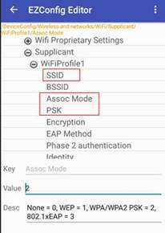
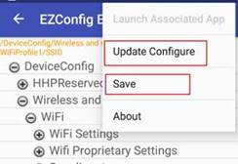
Note：Wifi Configuration
If you want to clone Wifi Configuration,you should configure Wifi in EzConfig instead of configuring Wifi in Settings.
Step 1.Open EzConfig. Configure SSID,Assoc Mode,PSK.
SSID:Target Wifi SSID
Assoc Mode:2
PSK: Target Wifi password
Step 2. Click Save,then click Update Configure.
Step 1
Step 2

